Slide 1
VERSATILE HUB -SLICE OF ARTS
TEAM MEMBERS:
1.R.RAMYASRI -2451-16-737-006
2.A.JYOTHI-2451-16-737-008 guide:
3.Md.salman-2451-16-737-022 K.CHANDRA SEKHAR 4.a.bhavana-2451-16-737-023 Assistant professor.,itd

Slide 2
STATEMENT OF PROBLEM
Students , apart from their academic skills , should take part in different activities in order to strengthen their other abilities.
Creativity is now important in education as literacy and we should treat it with same status.
Sparing some time in co-curricular activities help a student to get better grades , manage their time effectively and they can be capable of building their network strong.
Most importantly they can gain experience out of all these activities through planning . They can relax and have fun too!!

Slide 3
SCOPE OF THE PROJECT
So , we have come up with a project which correlates with the above statement.
Our project , VERSATILE HUB provides a platform which unites various events like Music , dance , coding and many more .. with which students can improve their skills in interested fields.
They can have active participation in many cultural , technical events that barely rise in today’s running society, and thereby trying to ignite their young minds.

Slide 4
Software specifications
Software requirements:
HTML5 ,CSS, PHP , XAMPP Server(MY SQL)
Hardware requirements:
Hard disk , 4GB RAM , Processor (64 bit) , Operating System (Windows)

Slide 5
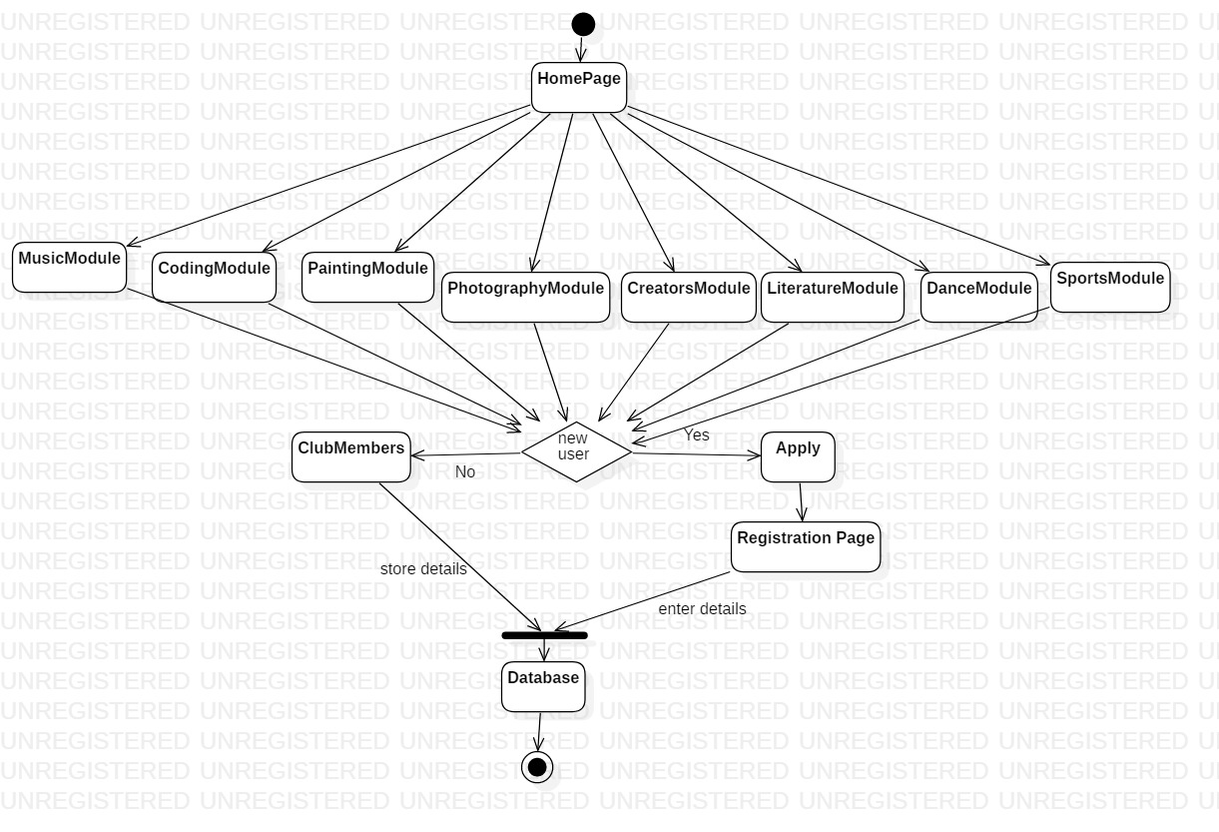

Slide 6
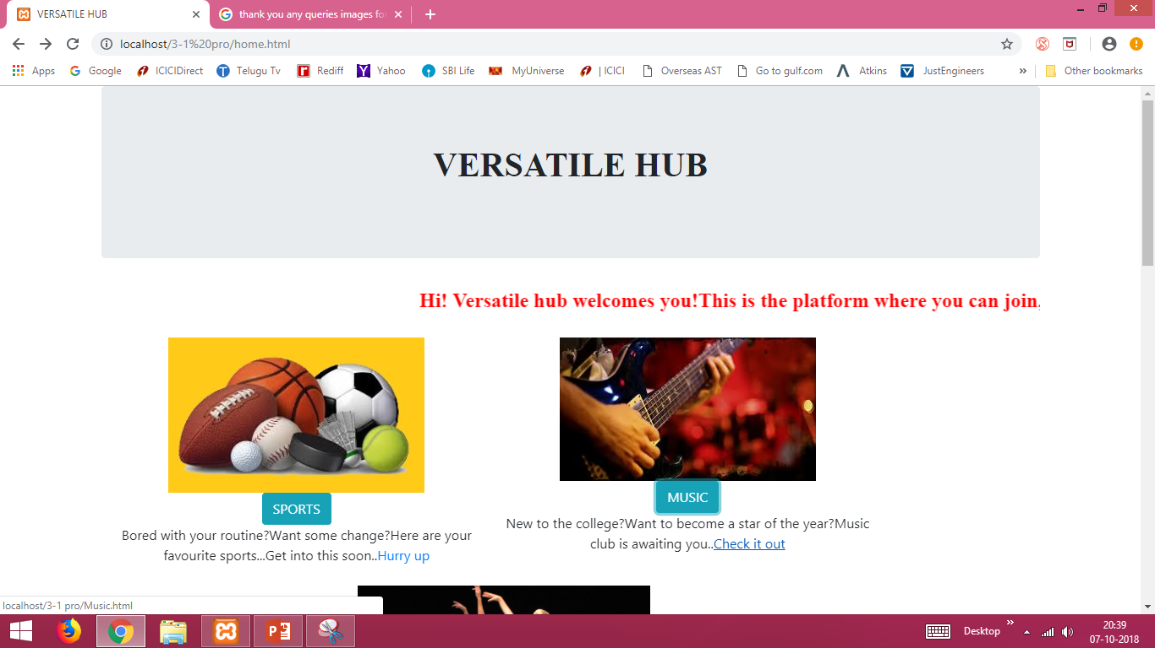

Slide 7
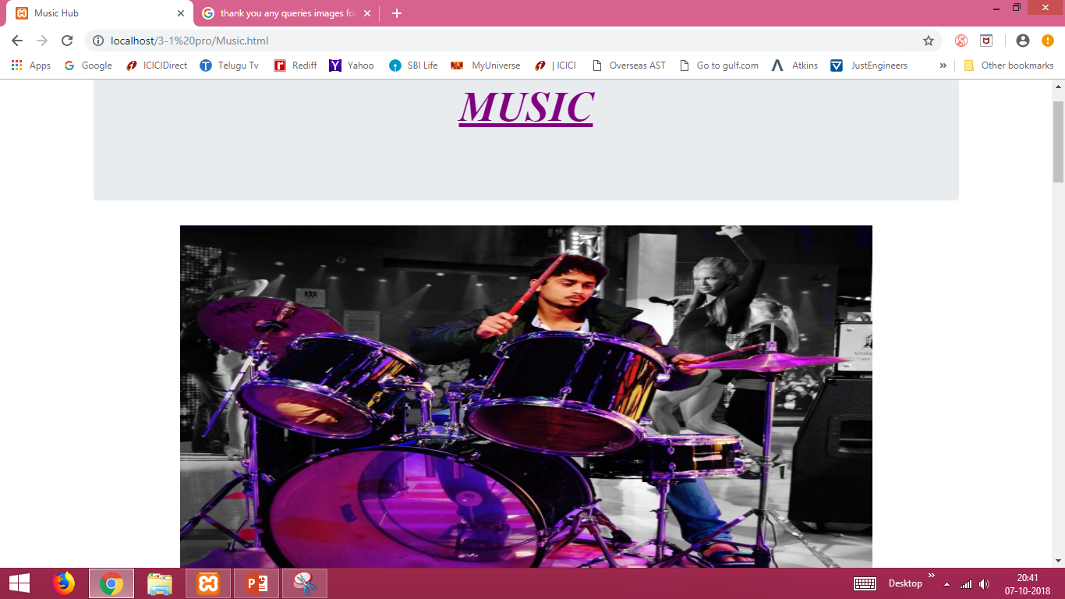

Slide 8
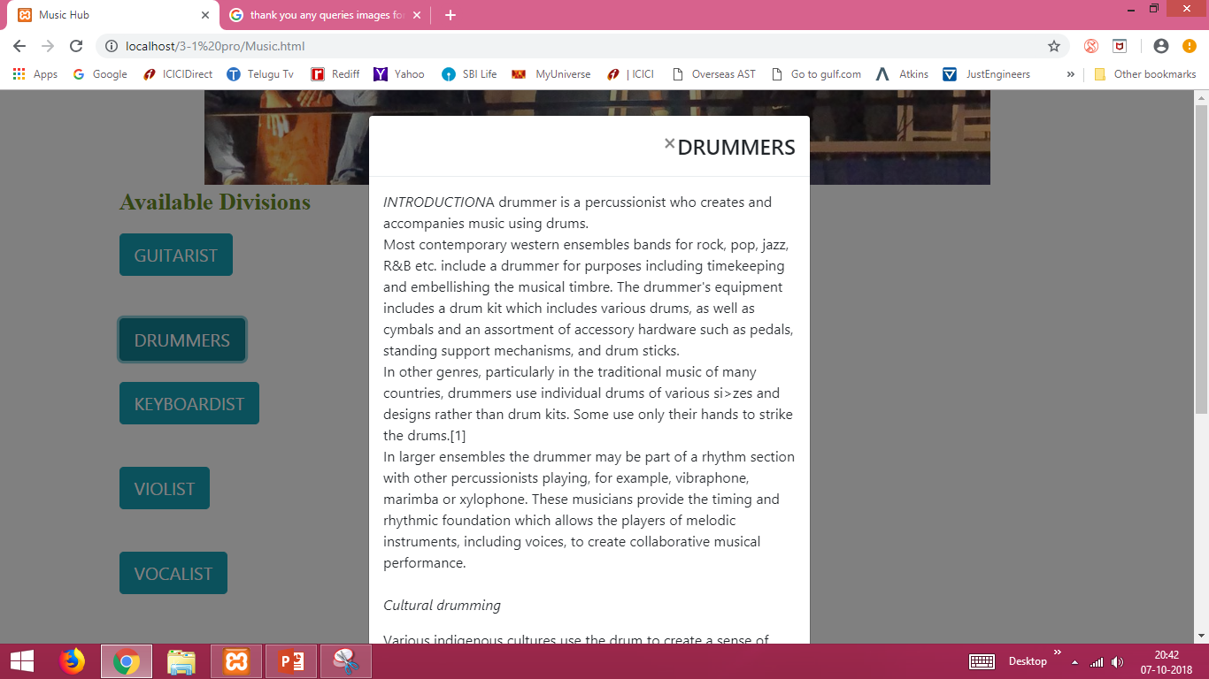

Slide 9
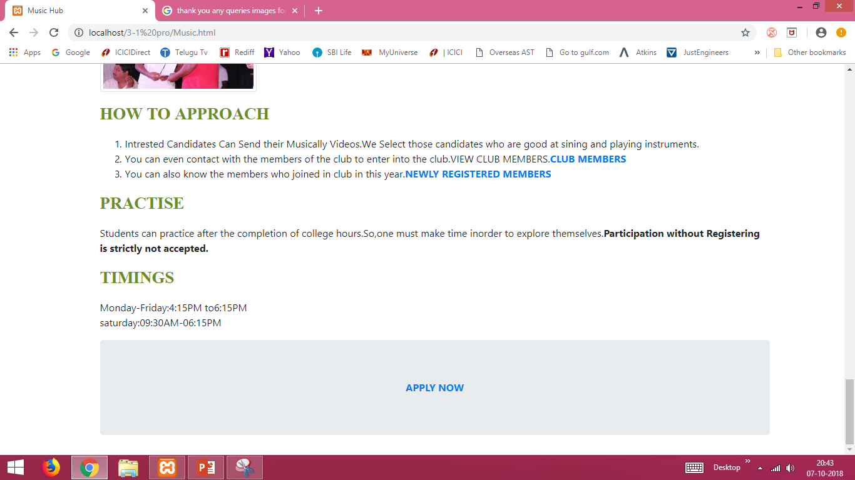

Slide 10
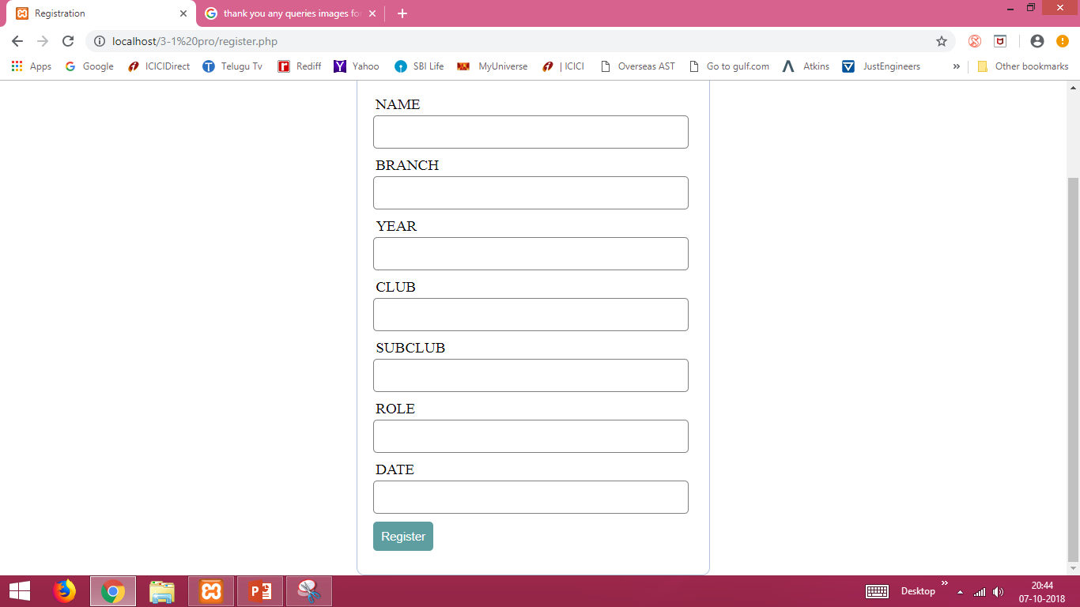

Slide 11
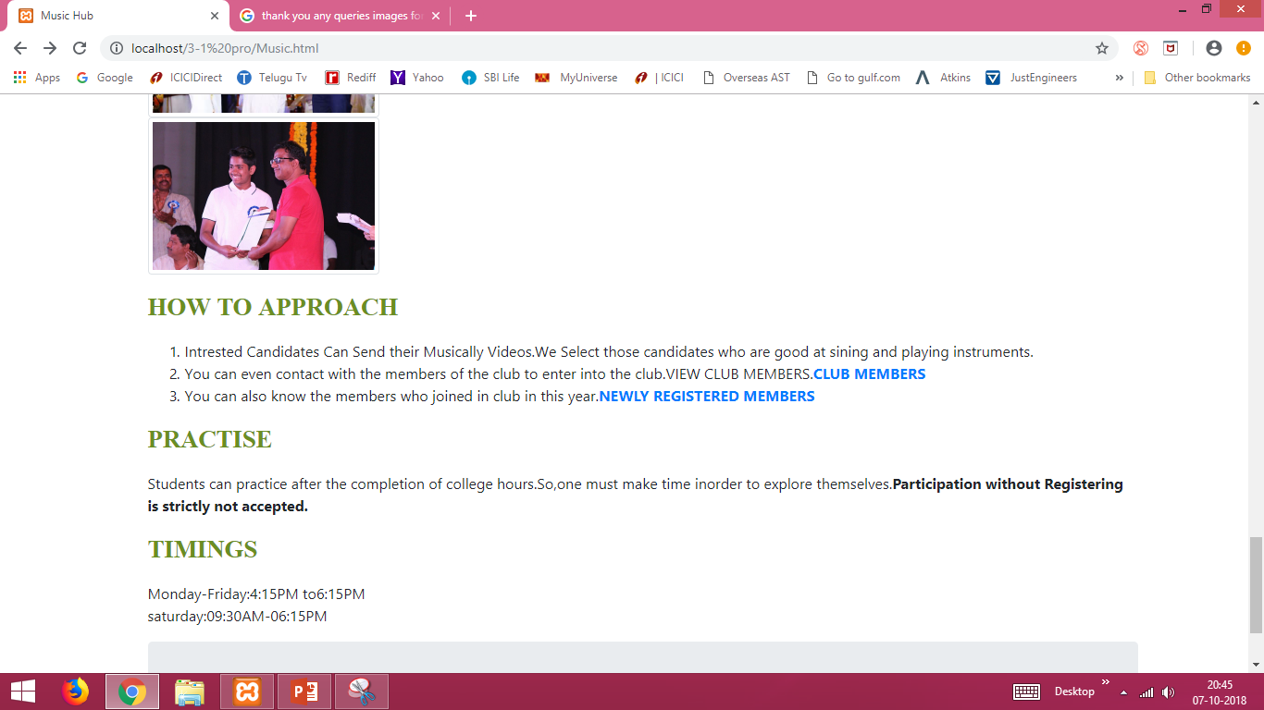

Slide 12
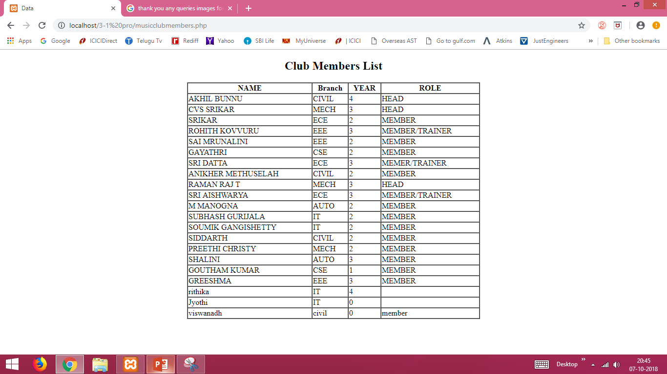

Slide 15
CONCLUSION
It builds common platform for exchange of information among the students. Using this one can explore themselves by participating actively in all the Events. This project will help the students to enlighten their skills which may even pave the way for their future career.

Slide 16
FUTURE SCOPE
We can update the student details.
We can add the new clubs that rise out of the students talents.
We can connect it to the main server .
We can use the real time forum page for the feedback of students.

Slide 17
REFERENCES
1. https://www.w3schools.com/html/default.asp
2. https://www.w3schools.com/css/default.asp
3. https://codewithawa.com/posts/complete-user-registration-system-using-php-and-mysql-database
4. https://youtube/IHdd02IK2Jg
5. https://youtu.be/C--mu07uhQw
6. For the information about students in various clubs we consulted the respective heads of different clubs.

Slide 18


